Slide 1
How to classify bird chirps while drinking the best wine ?
Dominik Koterwa
Jakub Bandurski
Machine Learning 2

Slide 2
Classification problem
Machine Learning 2

Slide 3
Dataset description
16 941 audio files of 264 bird species from all around the world.
Birds were recorder by users and then the files of recordings have been sent to the Cornell Lab of Ornithology.
There are birds for which multiple samples are present. However, there exist species for which only one audio sample is recorded.
Samples have variable length and are of different quality.
Machine Learning 2

Slide 4
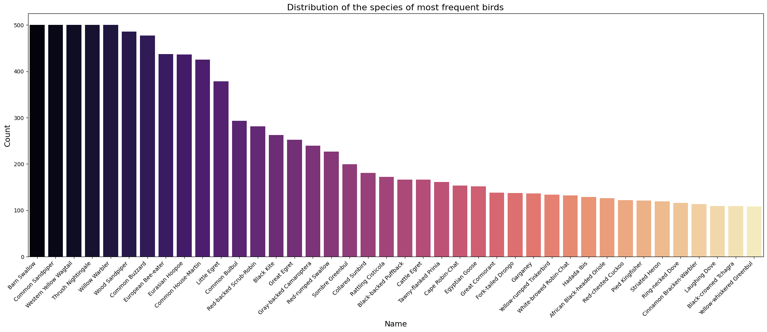
Exploratory Data Analysis (1)
Machine Learning 2

Slide 5
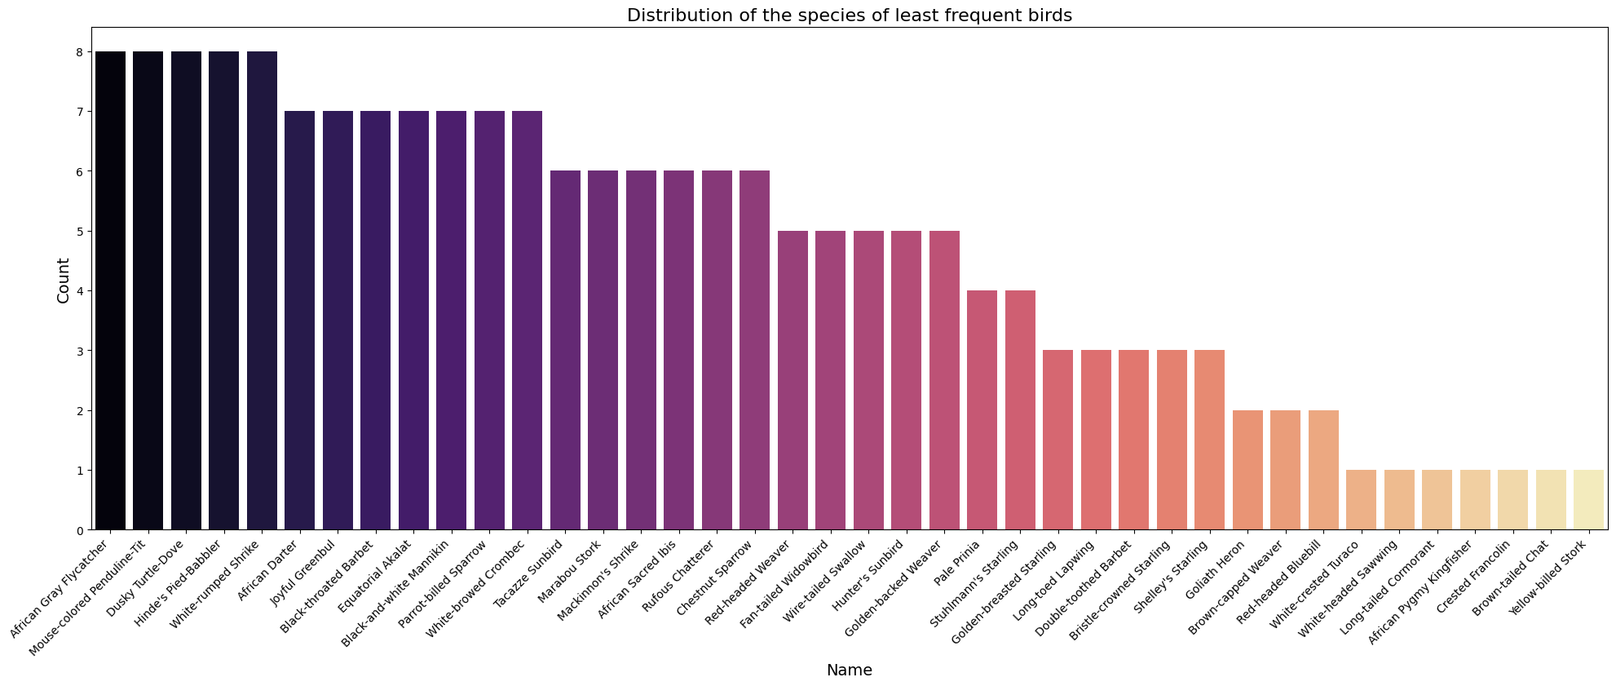
Exploratory Data Analysis (2)
Machine Learning 2

Slide 6
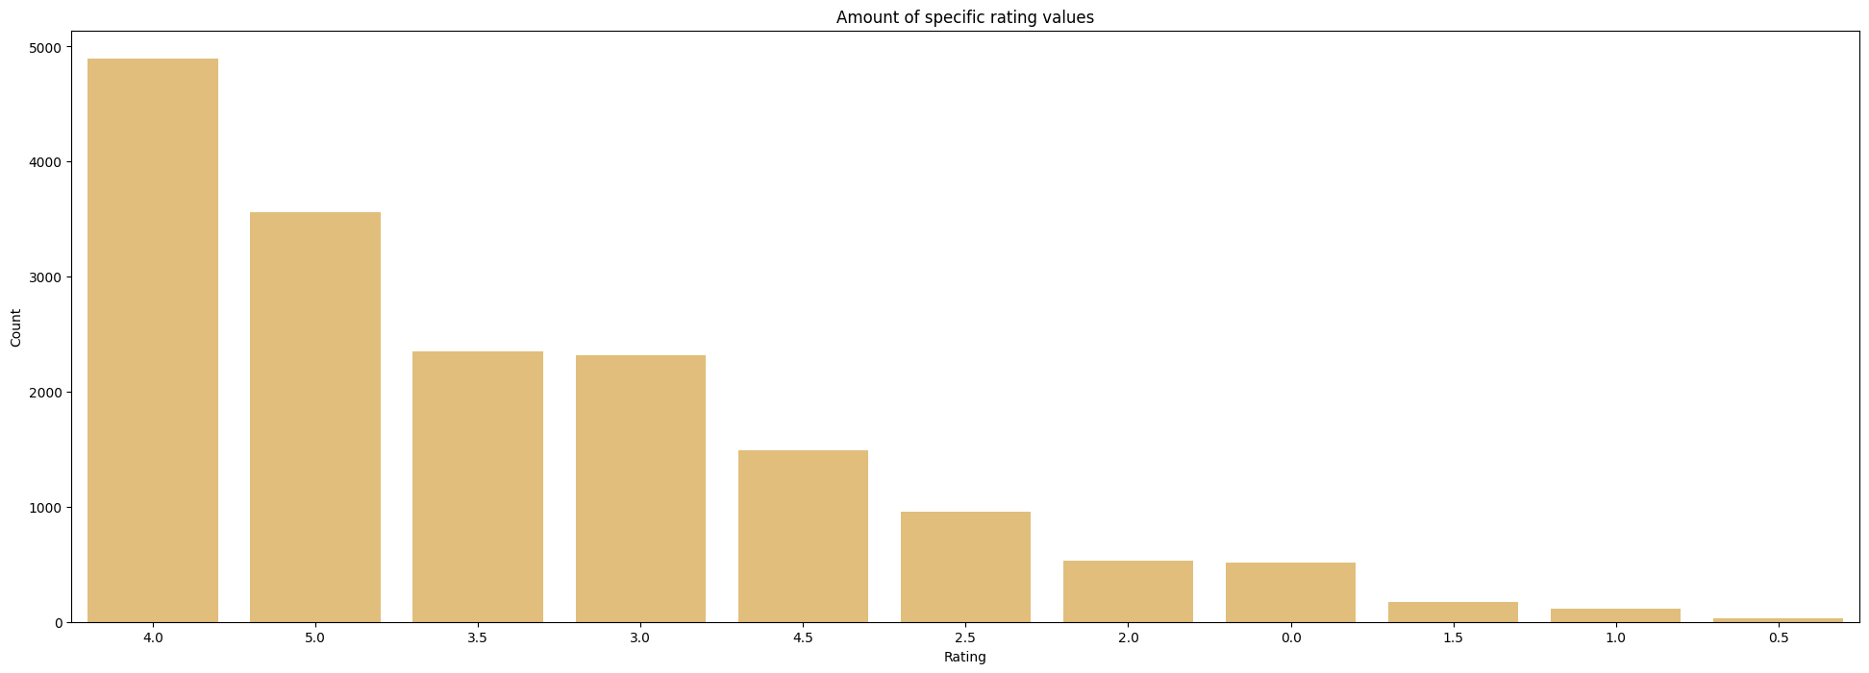
Exploratory Data Analysis (3)
Machine Learning 2

Slide 7
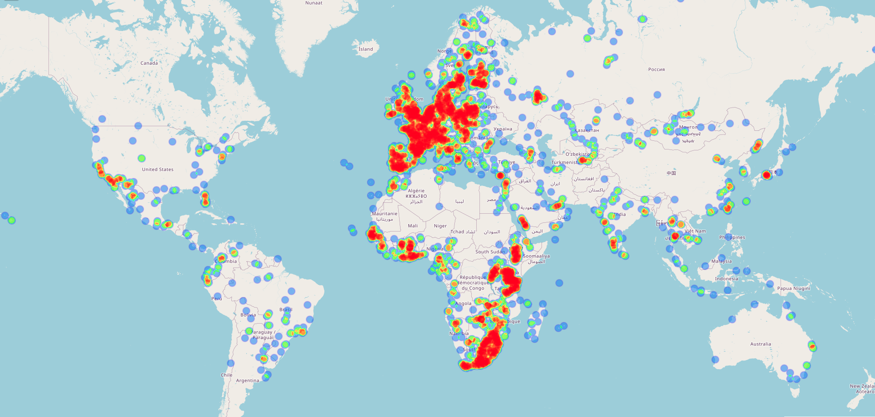
Exploratory Data Analysis (4)
Machine Learning 2

Slide 8
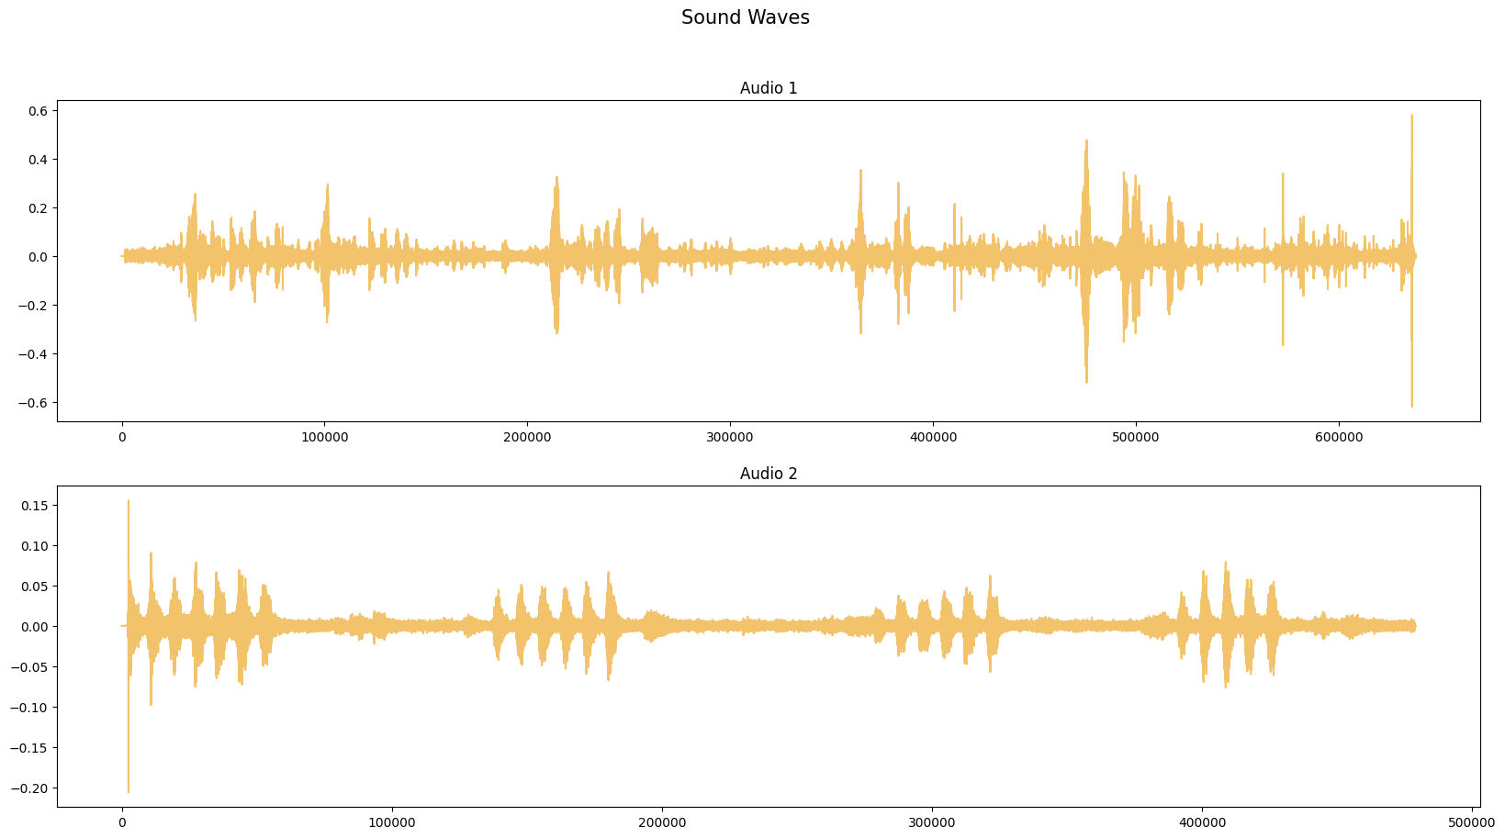
Sound representations - waveform
It shows how the amplitude of a signal changes with time, giving a direct view of the loudness or intensity of the sound at each moment.
Machine Learning 2

Slide 9
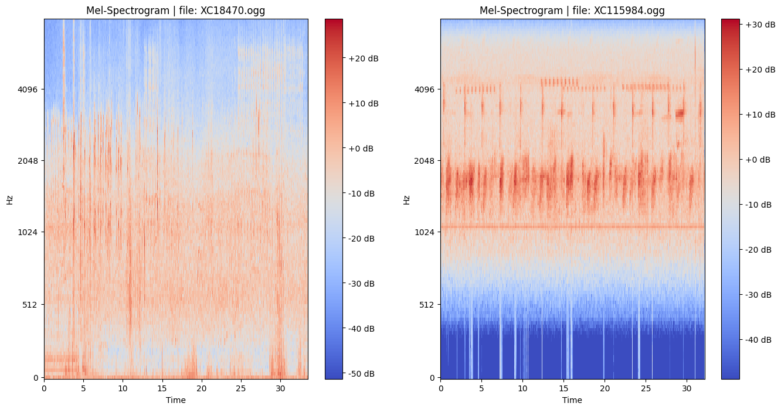
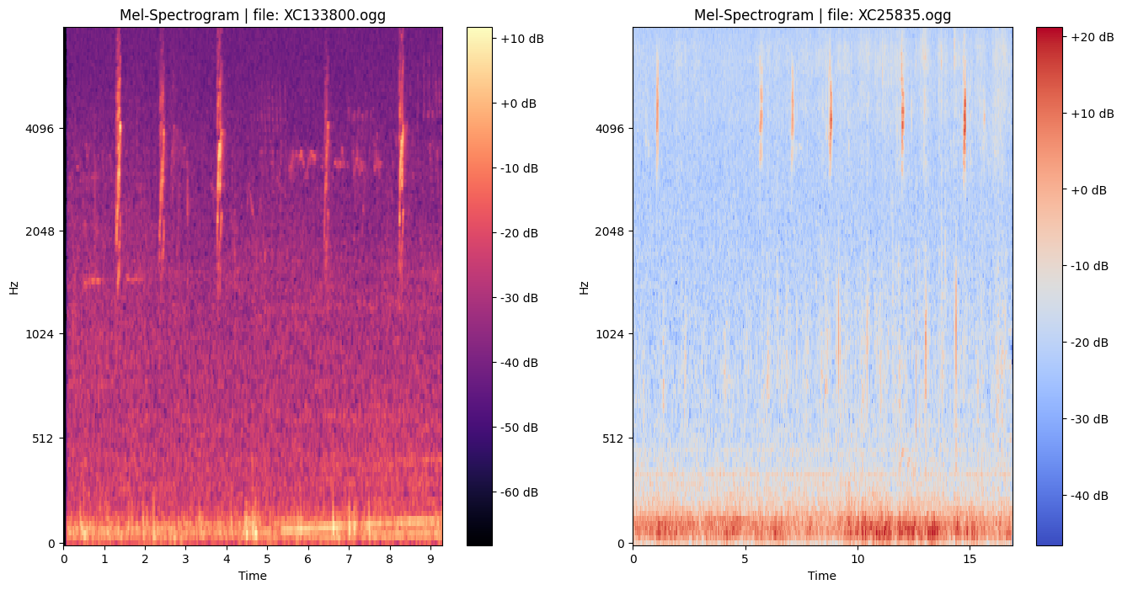
Sound representations - mel spectrogram
What is it?
A mel spectrogram is a visual representation of an audio signal where the frequency scale is converted to the mel scale, emphasizing how humans perceive sound, particularly highlighting lower frequencies.
How is it made?
Every continuous time-based signal can be represented as a sum of sinusoidal functions (sines and cosines) of various frequencies, amplitudes, and phases.The Fourier Transform takes a signal in the time domain (like a sound wave, which varies over time) and represents it in terms of the frequencies that make it up.
Machine Learning 2

Slide 10
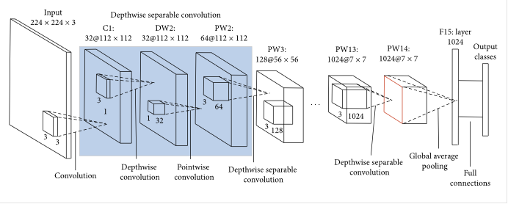
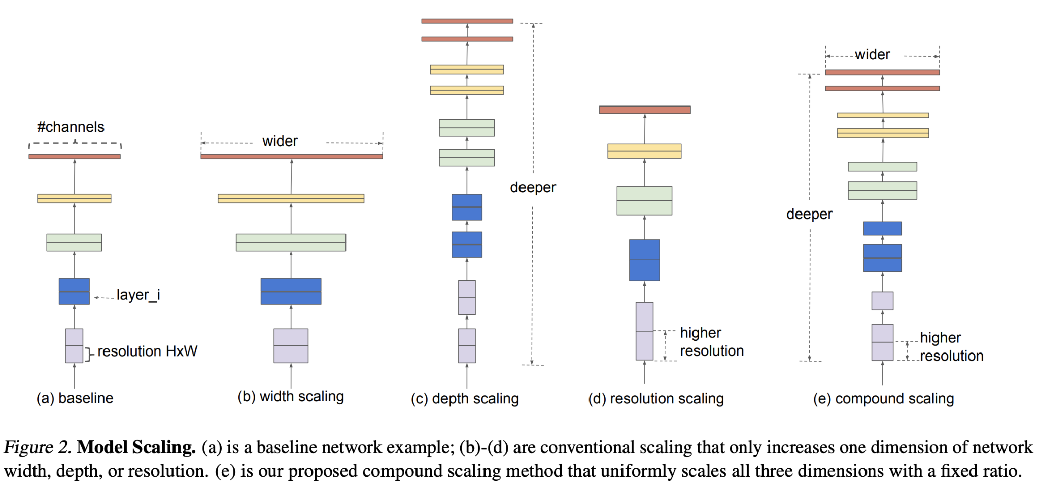
Used models and parameters
Models were trained using lambda labs GPU services. I’ve used:
batch size = 32
learning rate = 0.00001
optimizer = Adam
epochs = 50
*Classes with less than 5 observations were excluded because stratified sampling could not be performed.
Used models
Mobile Net (5.5M parameters)
Efficient Net (118.5M parameters)
Machine Learning 2

Slide 11
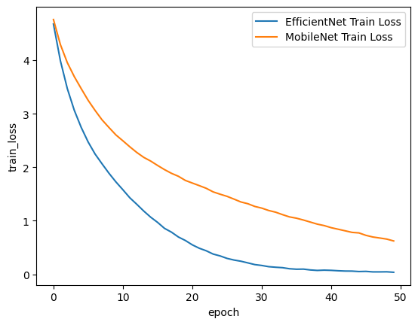
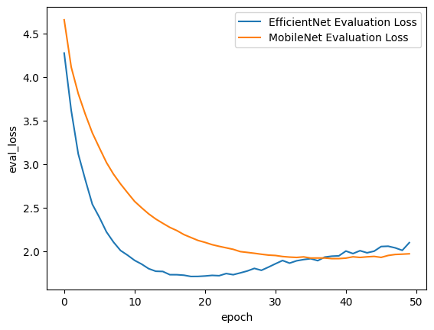
Machine Learning 2

Slide 12
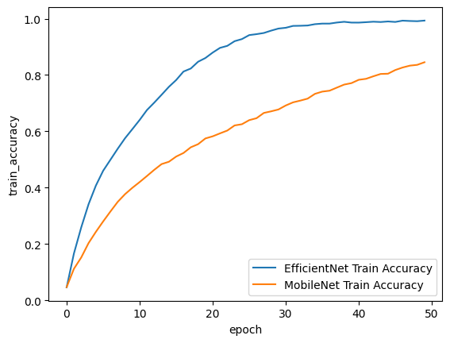
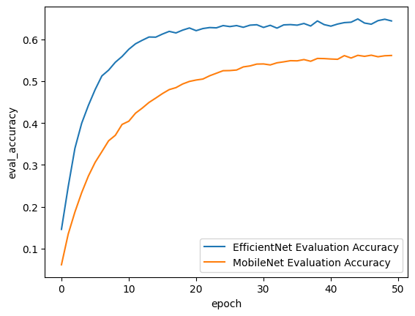
Machine Learning 2

Slide 13
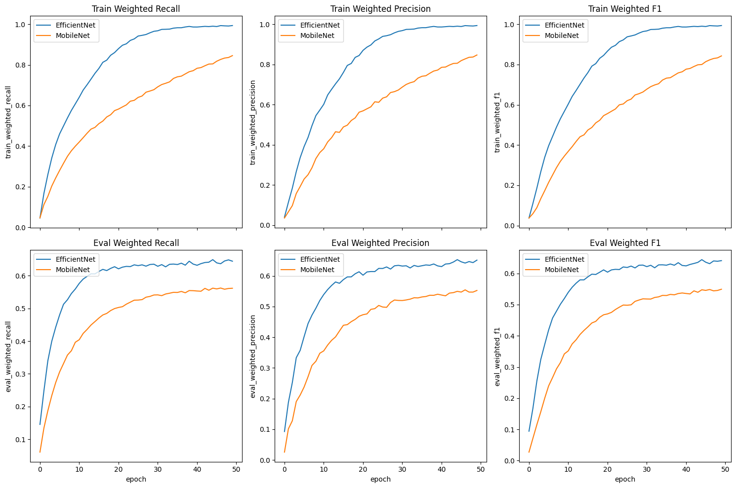
Machine Learning 2

Slide 14
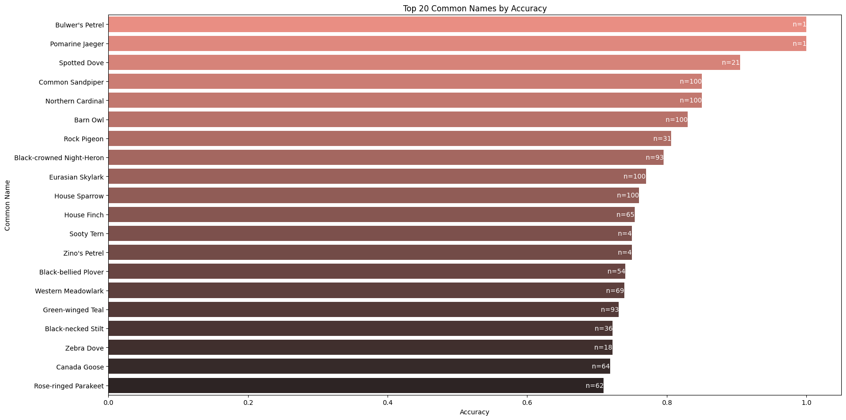
Best accuracies on evaluation dataset
Machine Learning 2

Slide 15
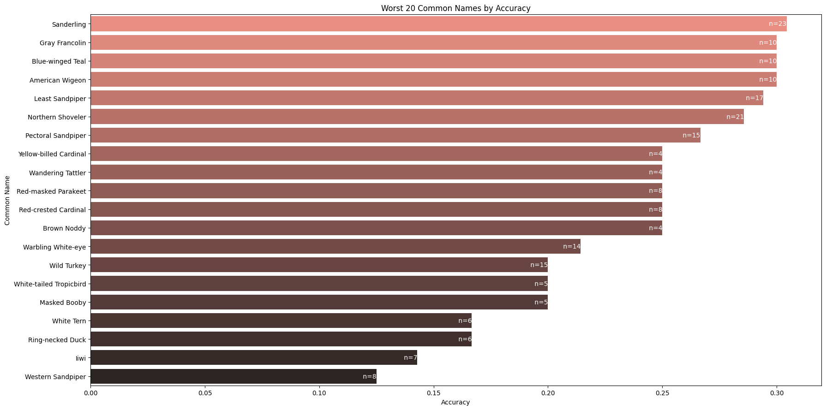
Worst accuracies on evaluation dataset
Machine Learning 2

Slide 16
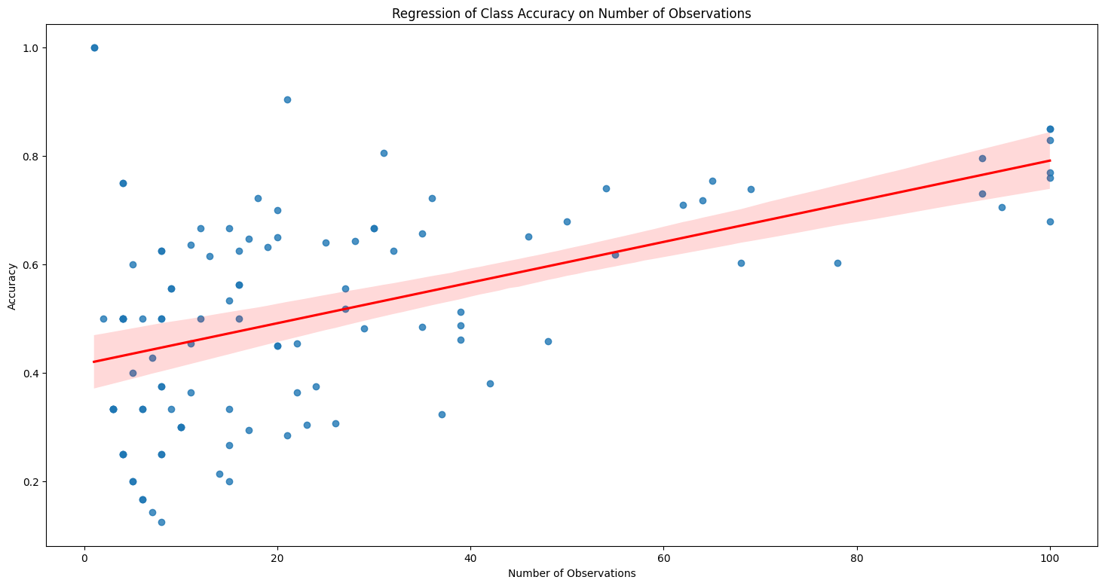
Is it even worth adding classes with small amount of observations to your deep learning pipeline?
Machine Learning 2

Slide 17
Conclusions
It can be clearly seen that using a much larger model provided a significant improvement. Scaling laws work really well in deep learning.
This dataset is excellent for practicing with data augmentation techniques, I even wrote the code to apply one, but unfortunately it is connected with costs.
Is a model pre-trained on real-life images really the best solution for audio? How can it get the general knowledge about audio sounds distribution during pre-training if they are not inside the dataset?
Research in Computer Vision is expensive :( I paid ~8$ for my experiments. It gives ~1$ for one run (I made some preliminary testing). If I would like to test 4 architectures * 4 learning rate levels * 4 types of batch size * 2 types of augmentation, then it would cost ~128$ (not a student’s budget).
However, I highly recommend using lambda labs GPU services. It is transparent and the price is fair.
Machine Learning 2

Slide 18
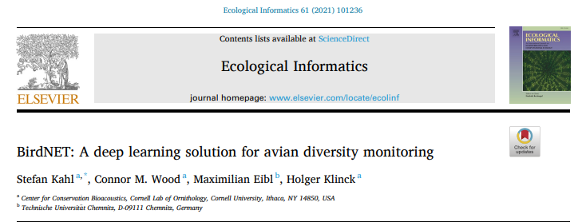
If you would like to read more about this task

Slide 19
Regression problem
Machine Learning 2

Slide 20

Dataset description
1400 wines in the initial dataset, train test split of 20%
The target variable is wine quality represented as integer score 0-10
Each observation has 21 features ranging from chlorides content to mysterious feat04 thrown in by our lecturer :)
All features are numeric which makes life easier for model development
Based on: Cortez,Paulo, Cerdeira,A., Almeida,F., Matos,T., and Reis,J.. (2009). Wine Quality. UCI Machine Learning Repository. https://doi.org/10.24432/C56S3T.
Machine Learning 2

Slide 21
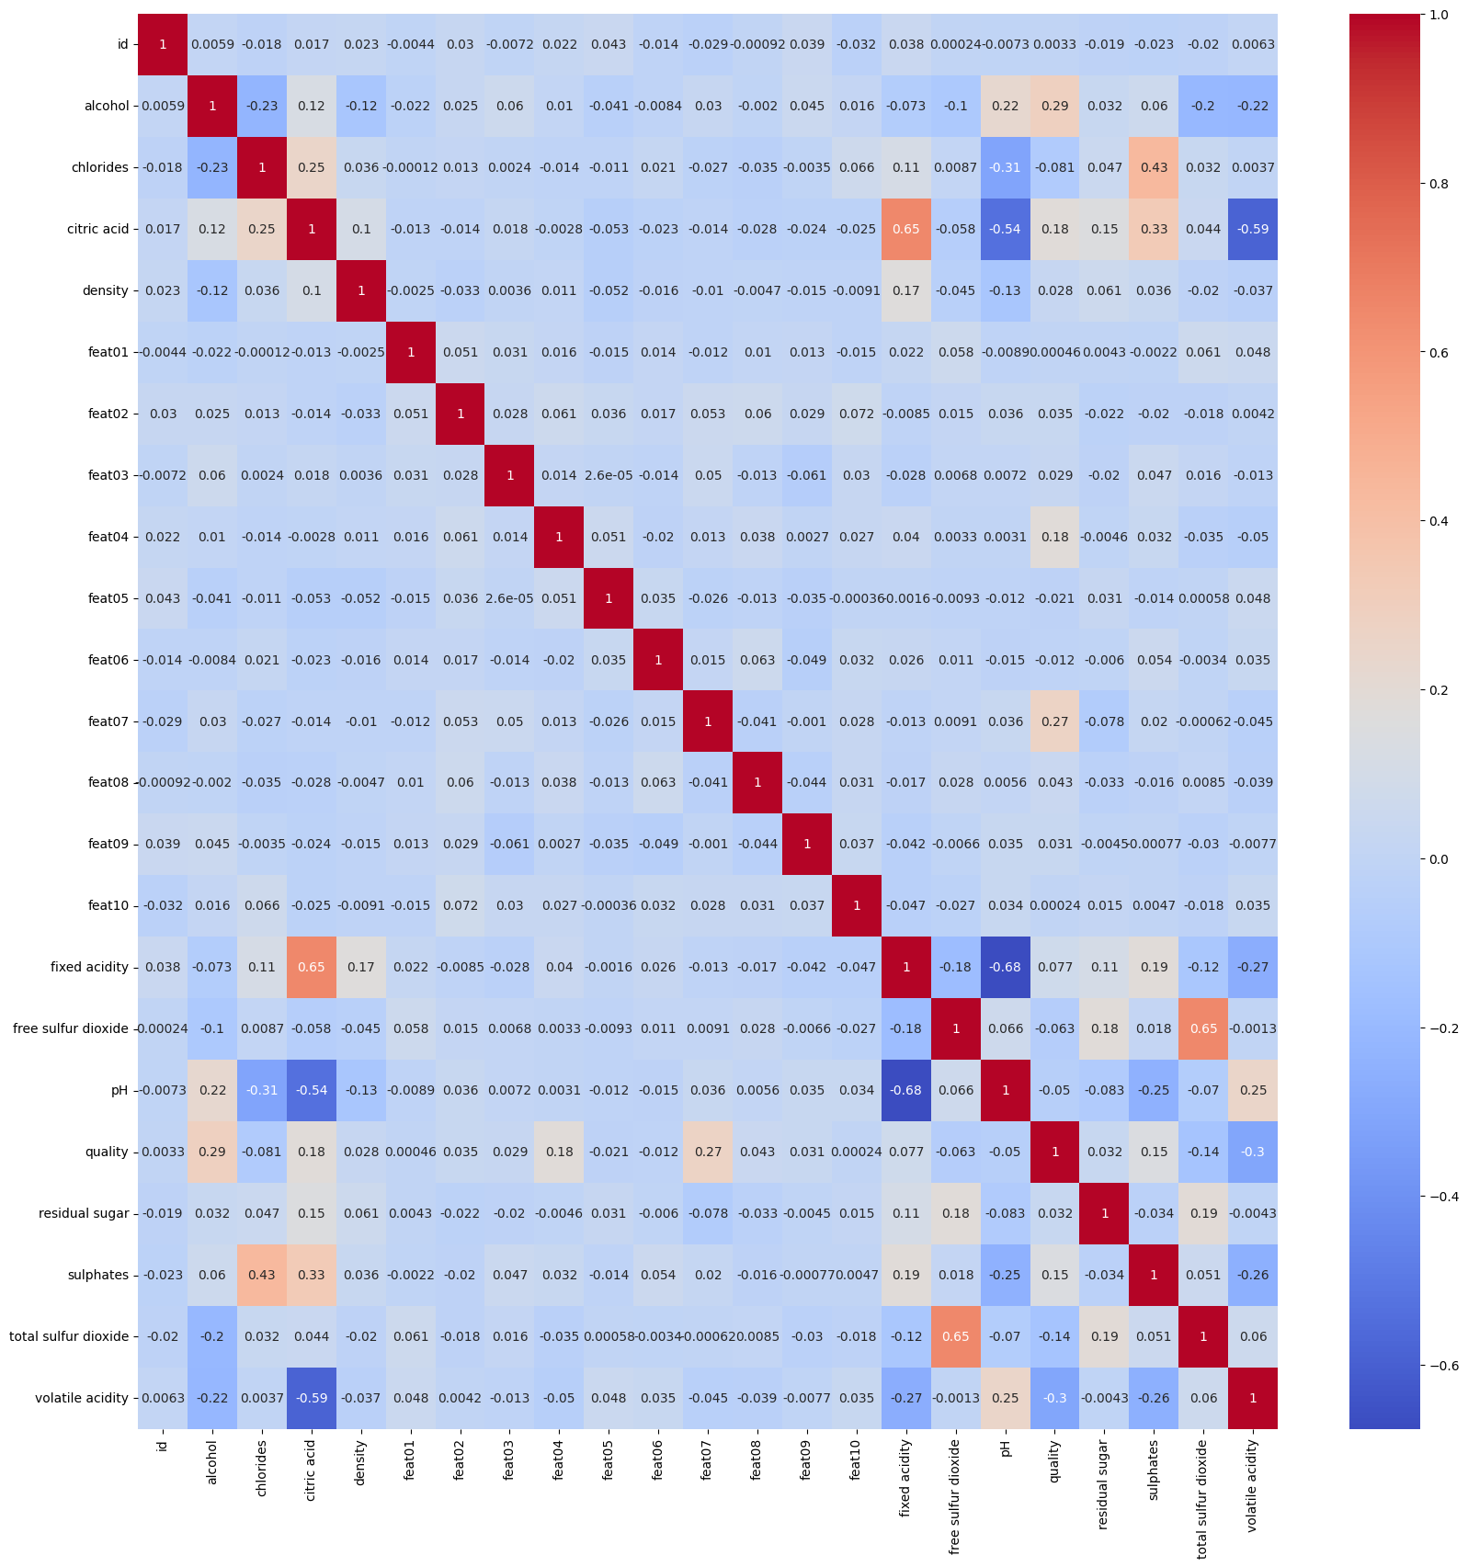
Let’s deal with suspicious features
Detecting random noise with statistics
Check the correlation matrix with heatmap overlay
Compare distribution plots
Perform statistical tests looking for distributions
Machine Learning 2

Slide 22
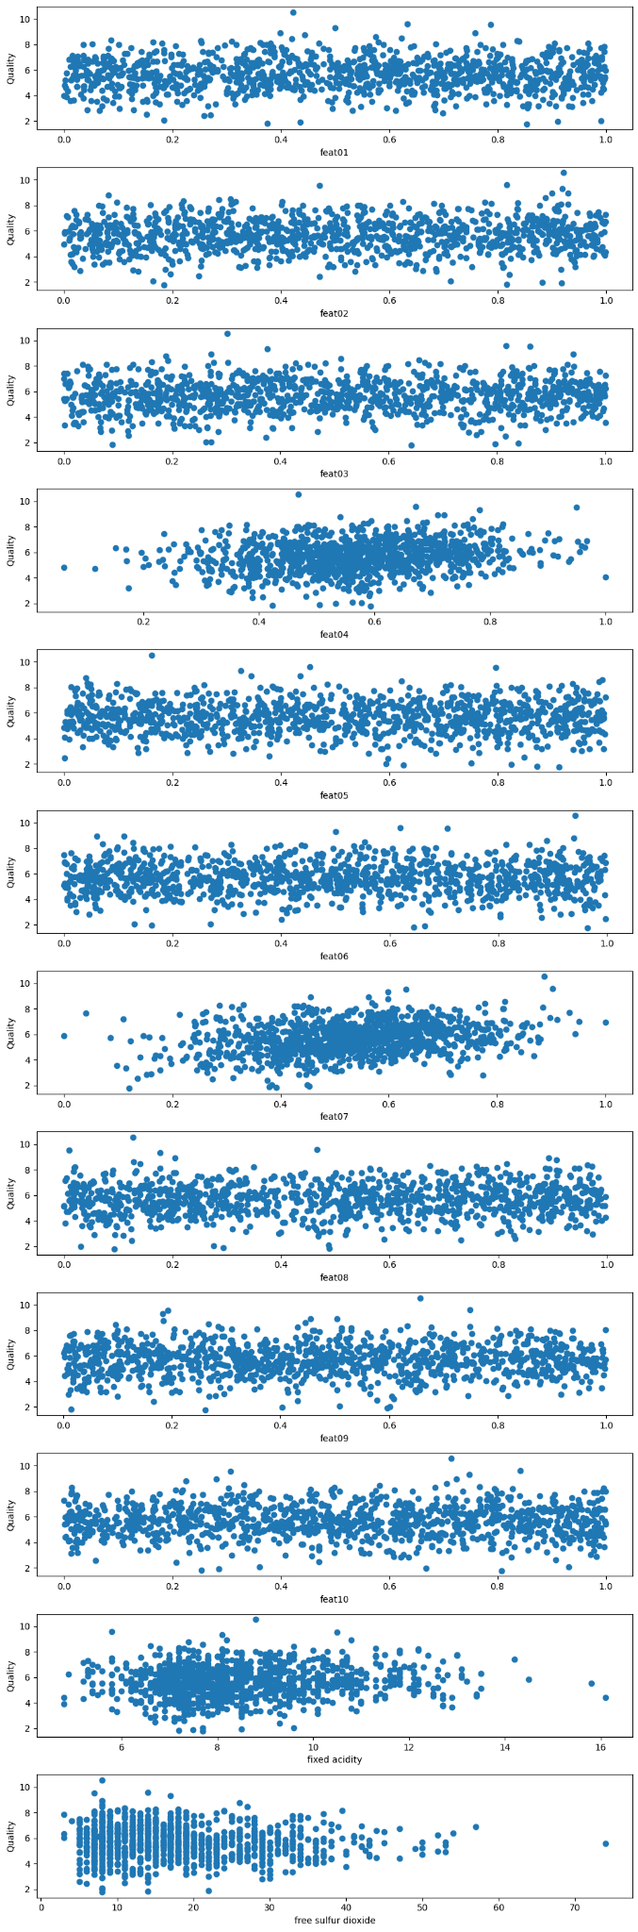
Let’s deal with suspicious features
Premises:
no correlation with target variable
distribution matches exactly Uni(0,1)
randomness scatter plot
Kolmogorov-Smirnov test H0
Machine Learning 2

Slide 23
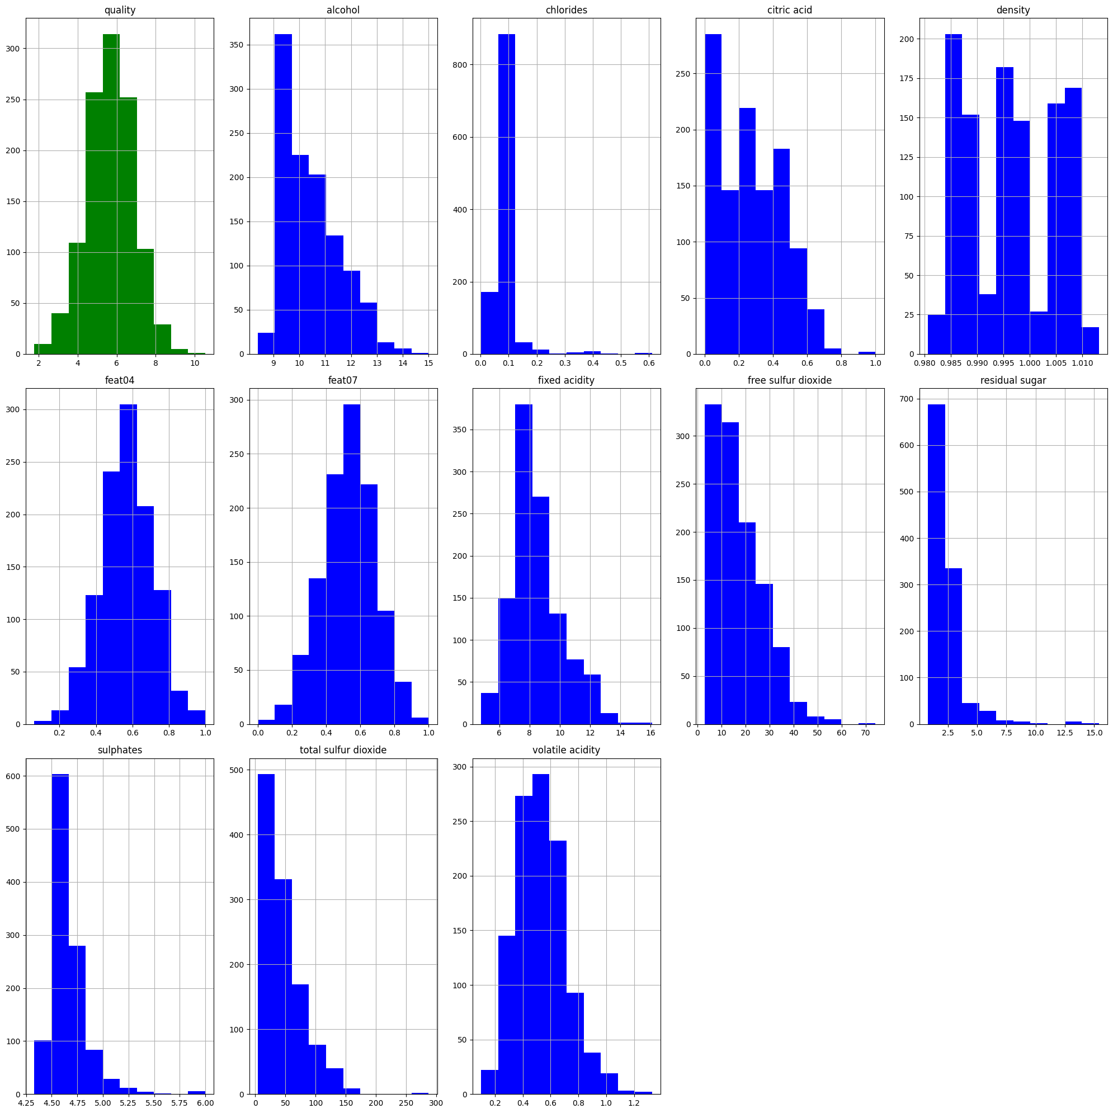
Characteristics distributions
quality ~ normal
feat04, feat05 ~ quality
chlorides, residual sugar, sulphates concentrated
density – three groups
Machine Learning 2

Slide 24

Pipeline design
Hyper Parameters Tuning
Tuning
Strategy
K-fold Cross Validation
Data Transformation
Model Training
Model Validation
Training Dataset
Experiment Tracking
Machine Learning 2

Slide 25
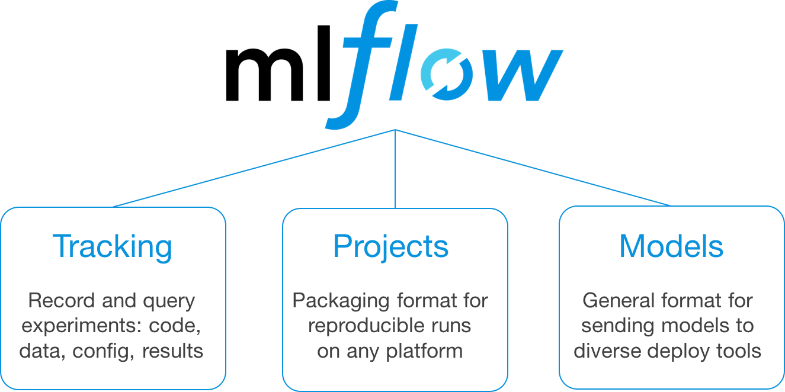
mlflow short overview
https://www.databricks.com/blog/2018/06/05/introducing-mlflow-an-open-source-machine-learning-platform.html
Machine Learning 2

Slide 26
Models used for regression
Elastic net
alpha
l1 ratio
XGBoost
learning rate
number of trees
max depth
subsample
min child weight
3. Neural Network
hidden layers
neurons
activation functions
learning rate
dropout rate
epochs
batch size
Machine Learning 2

Slide 27
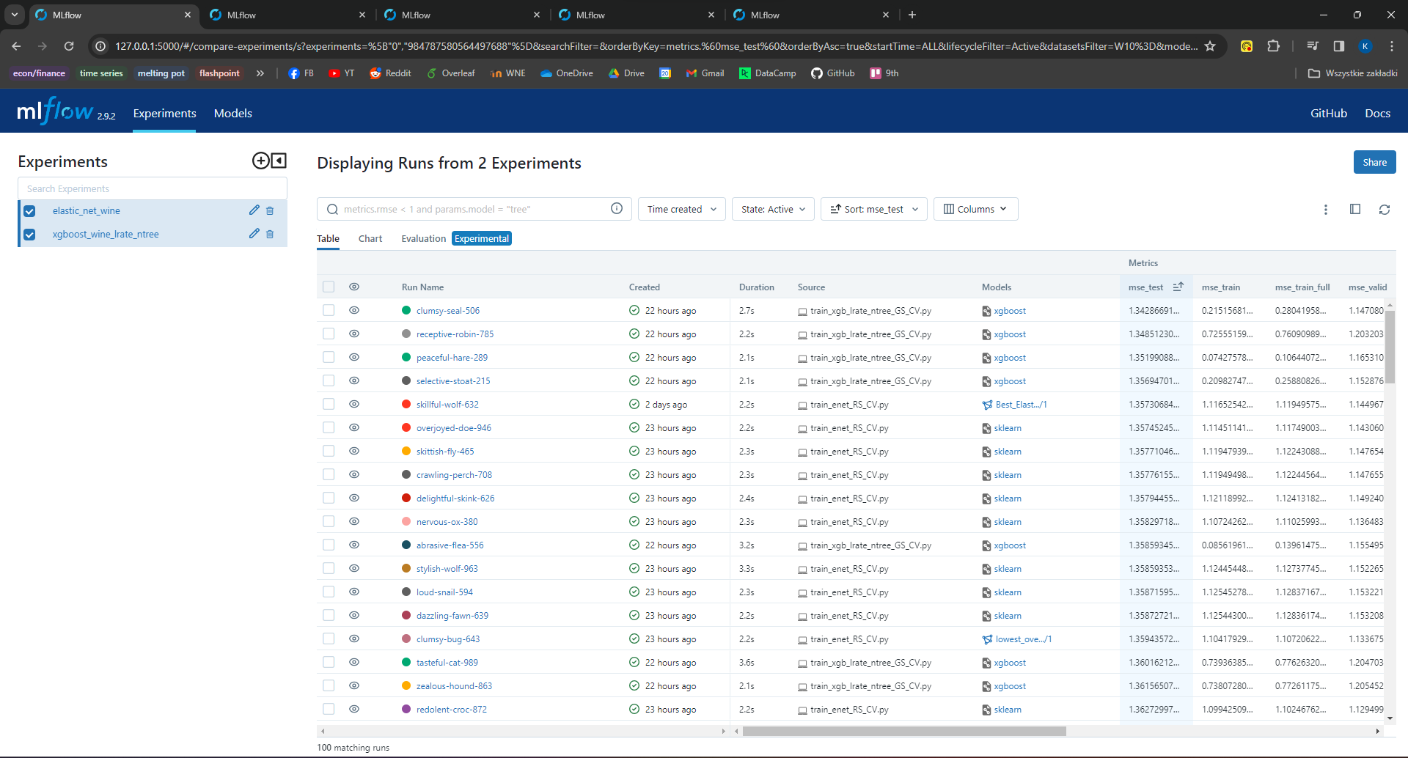

https://youtu.be/qHeokeuLMTg
Machine Learning 2

Slide 28
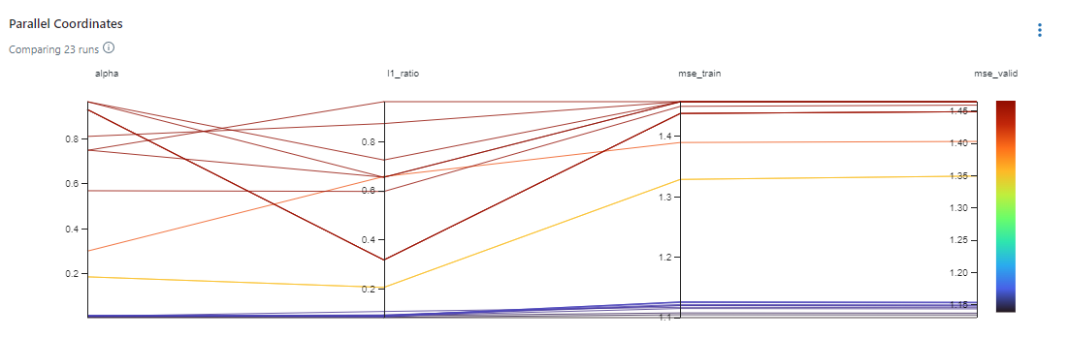
Parallel coordinates plots
Elastic Net
Machine Learning 2

Slide 29
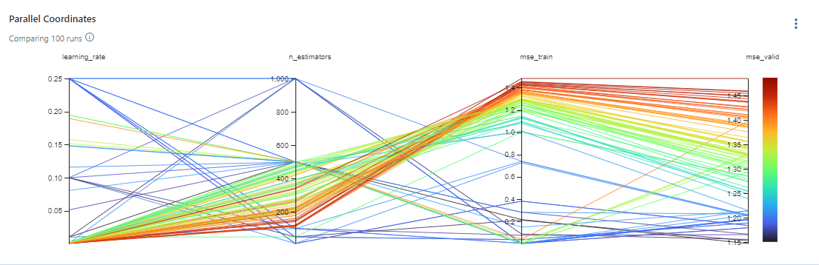
Parallel coordinates plots
XGBoost
Machine Learning 2

Slide 30
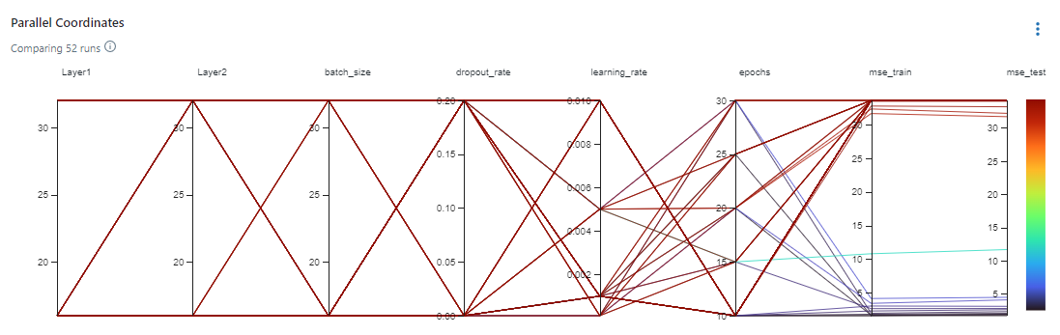
Parallel coordinates plots
Neural Networks
Machine Learning 2

Slide 31
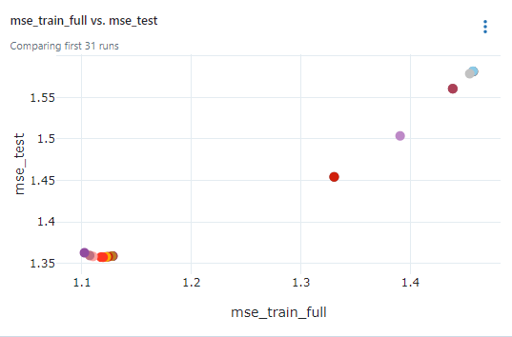
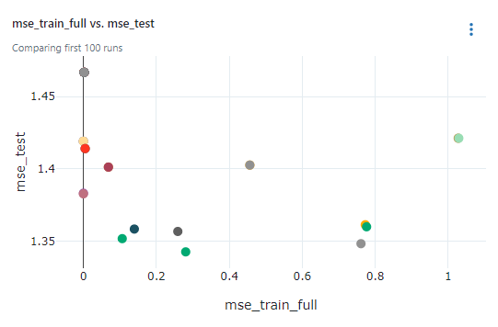
Scatter plots for overfitting detection
Elastic Net XGBoost
Machine Learning 2

Slide 32
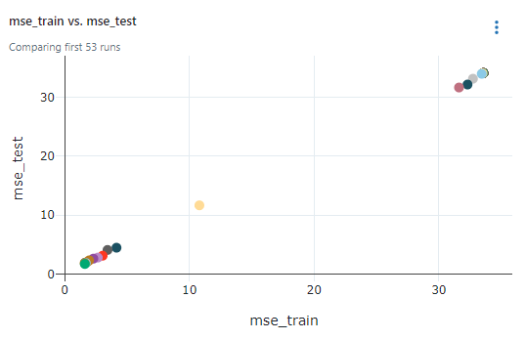
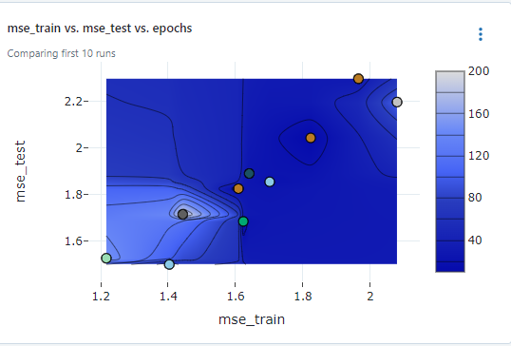
Scatter plots for overfitting detection
Machine Learning 2

Slide 33
Results
XGBoost (1.34) < Elastic Net (1.35) < Neural Networks (1.52) (mse test)
Elastic Net < Neural Networks < XGBoost (overfitting)
Interesting observation XGBoost huge overfitting, Neural Nets almost as Elastic Net
Small dataset didn’t let the XGB and NN shine, therefore we would recommend to use Elastic Net, or perhaps SVR for this task
Machine Learning 2

Slide 34


Experience with mlflow
Small dataset allowed for quick learning
Compatibility with python, R, most ML packages
Great UI
Smooth tracking of CV requires class modifications
Tensorflow and mlflow packages have their issues
Machine Learning 2

Slide 35

Lessons learned
Look out for random noise in the data, especially when datasets are vaguely described
Dataset too small for more advanced models to shine
Prevent information leaks
Remember to transform data within CV folds
mlflow framework very much recommended
Remember that new frameworks come with learning curve and time spent on stackoverflow and github
Machine Learning 2

Slide 36

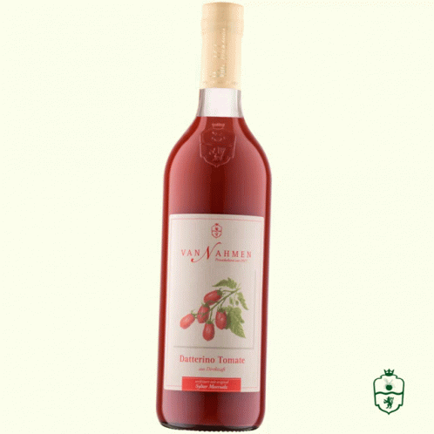
Thank you!
Machine Learning 2

